Slide 1
European HealthCare/Insurance System
Name
Institution
Date

Slide 2
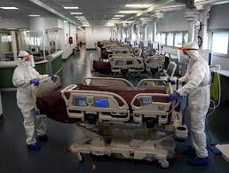
Introduction
Most European countries are known for offering high-quality healthcare to their residents.
The European healthcare system is well equipped.
This then makes it easy for citizens to opt for government insurance (Sokol, 2019).
Therefore, everyone can access quality healthcare without incurring financial harm.
Notes:
Most of the European countries are known for offering high-quality healthcare to their residents due to their social and economic status. Largely, the European healthcare system is well equipped to even compete with the top private health insurance companies. This then makes it easy for citizens who cannot afford private health insurance or are unable to pay for government insurance to access quality health services. As a result, everyone is able to access quality healthcare without incurring any financial harm (Sokol, 2019).

Slide 3
Reasons why the European HealthCare/Insurance System is Good. A) Universal Health Coverage
Almost every country in the European Union has universal health coverage for its citizens.
This is a system that provides quality medical services to all citizens (Speakman, 2019).
The governments primarily support universal healthcare coverage.
It is funded by the payroll taxes or the general income tax collected by the government.
Notes:
Basically, almost every country in the European Union has universal health coverage for its citizens. This is a system that provides quality medical services to all citizens. Besides, the federal government offers universal health coverage to its people regardless of their ability to pay. Due to the cost of providing high-quality healthcare services, this makes universal healthcare coverage to be primarily supported by the governments (Speakman, 2019). Notably, most universal healthcare coverage is funded by payroll taxes or the general income tax.

Slide 4
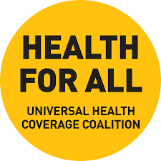
Benefits of Universal Health Coverage
It lowers the overall health care costs.
Low administrative costs (Stan et al., 2020).
Forces the hospitals and doctors to provide similar services at a low cost.
It helps create a healthier workforce.
Notes:
Universal healthcare coverage lowers the overall health care costs because the government controls the prices through regulation and negations. It also lowers administrative costs because the doctors only deal with one government agency. In addition, the coverage forces the hospitals and doctors to provide similar services at a low cost. Lastly, it helps create a healthier workforce. Notably, due to health care inequality, this is a major reason for the rising cost of medical care (Stan et al., 2020).

Slide 5
B) Mandatory Health Insurance
European nations have mandated health insurance for all their citizens.
In countries like Switzerland and Netherlands, it is strictly enforced.
Notably, citizens have the freedom to purchase insurance from any company of their choice or go for the public insurance option (Vollaard et al., 2016).
Nevertheless, some prefer to purchase private insurance as well as public health insurance.
Notes:
Besides, European nations have mandated health insurance for all their citizens. In countries like Switzerland and Netherlands, it is strictly enforced. However, citizens have been given the freedom to purchase insurance from any company of their choice or go for the public option. This is despite the governments' provided universal coverage, which is affordable for every citizen (Vollaard et al., 2016). However, in a country like Germany, the citizens prefer the public health insurance because it is cheaper and healthcare service provision is good. Nevertheless, some still prefer to purchase private insurance while still having public health insurance.

Slide 6
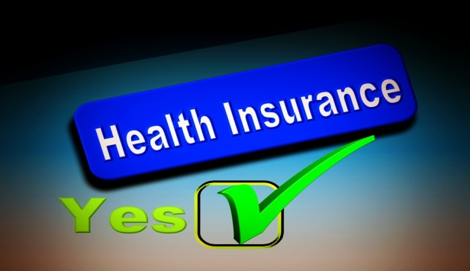
Benefits of Mandatory Health Insurance
It helps in saving money for people.
Notably, people incur a lot of expenses while paying for their medical bills.
However, in case of an emergency such as an accident, insurance saves a person from falling into long-term debt (Sokol, 2019).
Hence, the mandated health insurance helps the Europeans save huge amounts of money.
Notes:
Mandatory health insurance is beneficial because it helps in saving money for people, especially when the cost of medical care is expensive. When a person does not have insurance, they might incur huge cost while paying for their medical bills. However, in case of an emergency such as an accident, insurance saves a person from falling into long-term debt. Therefore, the mandated health insurance helps the Europeans save huge amounts of money (Sokol, 2019).

Slide 7
C) European Health Insurance Card (EHIC)
Another key feature is the European Health Insurance Card (EHIC).
EHIC is a card that gives EU citizens the right to access state-provided healthcare services when they visit any of the 28 EU countries.
Foreigners are entitled to the same medical assistance as the countries’ residents if they are from an EU nation (Speakman, 2019).
EU citizens can easily apply for the card through online platforms.
Besides, it is entitled to all citizens from the 28 EU nations.
Notes:
Another key feature that has enhanced quality healthcare in European countries is the European Health Insurance Card (EHIC). EHIC is a card that gives citizens from any European Union (EU) nation the right to access state-provided healthcare services when they visit any of the 28 EU countries. This means a foreigner is entitled to the same medical assistance as the countries residents if they are from an EU nation. Notably, the card can easily be applied for through online platforms, and no charges are incurred when one applies for the card. Besides, it is entitled to all citizens from the 28 EU nations (Speakman, 2019).

Slide 8
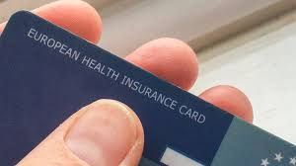
Key Benefits of the EHIC
The card helps the EU citizens save money.
This cover includes chronic conditions (Stan et al., 2020).
EHIC has a five-year renewal gap.
It also covers dentist services.
Notes:
The EHIC card helps the EU citizens save money when they travel. In addition, this card covers chronic conditions, which are rarely covered by other insurance policies. In addition, EHIC has a five-year renewal gap, which gives the Europeans a five-year free health coverage while visiting any state within the EU. The EHIC also covers dentist services, which in other insurance packages tend to attract a huge cost (Stan et al., 2020).

Slide 9
D) Best Clinics
European countries have some of the best clinics.
Besides, they are very effective and efficient (Vollaard et al., 2016).
The clinics are sometimes free or offer quality service at meager costs.
However, the cost insured can be refunded by the insurance company.
Notes:
Due to the good healthcare system, the European countries have some of the best clinics contributing to the effective healthcare system. Besides, these clinics are very effective and efficient. In addition, the clinics are sometimes free or offer quality service at very low costs. However, the insurance company can refund the cost insured if one presents a copy of the bills (Vollaard et al., 2016).

Slide 10
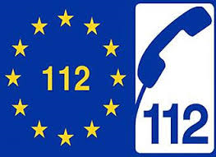
E) Universal Emergency Number
EU nations also have a universal emergency number that is 112 (Sokol, 2019).
Hence, while in their mother country or in a visiting country, EU citizens can always call for emergency aid.
In some countries, 911 is also applicable in case of an emergency.
This makes it easy for any citizen to access immediate medical aid.
Notes:
Additionally, the EU nations have a universal emergency number. Notably, in case of a life-threatening health problem while in their mother country or in a visiting country, EU citizens can always call 112, commonly for ambulances, fire departments, and police. In some countries, 911 is also applicable in case of an emergency. This makes it easy for any citizen to access immediate medical aid in case they need it (Sokol, 2019).

Slide 11
F) Pharmacies
In European countries, pharmacists have prescribing authority.
Hence, the EU citizens have been allowed to go to pharmacies in case of minor ailments by allowing insurance payments in them (Speakman, 2019).
Every city in Europe is required to have at least three 24-hour pharmacies.
This makes healthcare services to be easily accessible for all citizens.
Notes:
Moreover, in European countries, pharmacists have prescribing authority, unlike other countries. Besides, the EU citizens have been allowed to go to pharmacies in case of minor ailments. This is because pharmacists have been given the power to prescribe medicines for simple health conditions such as fever, cold, or muscle pain. In addition, every city in Europe is required to have at least three 24-hour pharmacies (Speakman, 2019). This makes healthcare services to be easily accessible for all citizens.

Slide 12

G) The Cost of Healthcare Services in Europe
Due to the universal healthcare coverage, the cost of healthcare in European countries is cheaper.
For instance, in France, the cost of a single night in the hospital is about $18.
While comparing this to America, one can hardly get a prescription for $18 (Stan et al., 2020).
Europeans have fewer out-of-pocket expenses for medical services.
Besides, they get high-quality medical services at a very low cost.
Notes:
Due to the universal healthcare coverage, the cost of healthcare in the European countries is very cheap. For instance, in France, the price of a single night in a hospital is about $18. While comparing this to America, one can hardly get a prescription for $18, let alone staying in the hospital (Stan et al., 2020). Therefore, Europeans have fewer out-of-pocket expenses for medical services compared to other nations. Besides, their medical services are of high quality despite the cost of healthcare services being very low.

Slide 13
G) The Minimum Age for Applying for Health Insurance in Europe
Children are considered beneficiaries of their parent's health insurance policies.
However, it is not against any law for a young person to have their own health insurance policy.
Notably, there is no health insurance age limit in the European insurance system.
This is unlike some countries like India, which have an age limit of 85 years (Vollaard et al., 2016).
Notes:
Notably, children who are still living with their guardians or parents are considered beneficiaries of their health insurance policies. Hence, they may not be required to get health insurance. However, it is not against any law for a young person to have their own health insurance policy. This is so provided that an employed adult is paying it. Notably, there is no health insurance age limit in the European insurance system. This is beneficial considering that some countries like India have a maximum health insurance limit of 85 years (Vollaard et al., 2016).

Slide 14

Cons of the European HealthCare/Insurance System
The healthcare cost overwhelms the government budgets (Sokol, 2019).
As a result, the European countries tax their citizens highly.
Therefore, many argue that citizens can just use the hugely taxed money to purchase equivalent private insurance.
Notes:
Notably, despite its tremendous benefits, the European HealthCare/Insurance System also has some flaws. The first is that the healthcare cost overwhelms the government budgets. As a result, the European countries tax their citizens a lot of cash to facilitate their healthcare and insurance coverage for their citizens. Therefore, many argue that the money can be equal to just purchasing private insurance for their own rather than being hugely taxed to fund the HealthCare/Insurance System due to the high taxes (Sokol, 2019).

Slide 15
Cons of the European HealthCare/Insurance System
People pay for services they do not use.
It encourages people to stop being watchful about their health.
This healthcare/insurance system limits the services.
For instance, EHIC is not applicable for someone visiting another EU nation for more than six months (Speakman, 2019).
Notes:
In addition, people pay for services they do not use. That is, not everyone who is taxed falls sick; hence, their funds are used by other people. Moreover, it encourages people to stop being watchful about their health. This is because people know that they can get free treatment at any time of the day. Also, this healthcare/insurance system limits the services. For instance, with EHIC, it cannot be used by someone visiting another EU nation for more than six months (Speakman, 2019).

Slide 16
Conclusion
Most of the European countries are known for offering high-quality healthcare to their residents.
The cost of healthcare in European countries is cheaper.
However, the healthcare cost overwhelms the government budgets.
Besides, many argue that this healthcare/insurance system limits the services.
Notes:
Most of the European countries are known for offering high-quality healthcare to their residents despite their social and economic status. Due to most of the countries' universal healthcare coverage, the cost of healthcare in European countries is cheaper. However, the healthcare cost overwhelms the government budgets. Besides, many argue that this healthcare/insurance system limits the services provided by the healthcare provides.

Slide 17
References
Sokol, T. (2019). The Right to Healthcare in the European Union and Canada: The Role of the Centre in Complex Entities. Croatian Yearbook of European Law & Policy, 15(1), 155-188.
Speakman, E. M. (2019). Gabriella Berki, Free Movement of Patients in the EU–A Patient’s Perspective.
Stan, S., Erne, R., & Gannon, S. (2020). Bringing EU citizens together or pulling them apart? The European Health Insurance Card, east–west mobility and the failed promise of European social integration. Journal of European Social Policy, 0958928720974188.
Vollaard, H., van de Bovenkamp, H., & Martinsen, D. S. (2016). The making of a European healthcare union: a federalist perspective. Journal of European Public Policy, 23(2), 157-176.

